Slide 1
R Cas:
A Parallactic Conundrum
Paul Hemenway
University of Denver
Physics and Astronomy Department

Slide 2
Acknowledgements
Toshiya Ueto and Bob Stencil
(for pointing out the astrometric-astrophysical
discrepancy)
Imants Platais
(for pointing me to the new HIPPARCOS
reduction)
Floor van Leeuwen for a last minute e-mail
AND OF COURSE:
Bill, for encouraging me in astrometry in the first
place, and for being the subject of this symposium.

Slide 3
Some personal notes on “BillvA”
1966/7 – Peter Pesch and Case Institute of Technology
1968-1973 – University of Virginia
1977 – 1996 –Texas & HST
    Bill and how to use 5 observations with HST to
    get a parallax accurate to a milliarcsecond in
    two and a half years.

Slide 4
How to separate a parallax and proper motion in 2.5 years
When our HST Astrometry Science Team first met in 1978, Bill van Altena laid out the “optimum minimum” observing schedule to get a good separation between parallax and proper motion: you need observations at at least five epochs well spaced over 2.5 years [and I assume close to the extreme points of the parallactic ellipse – PDH].

Slide 5
R Cas, Basic Characteristics, mostly from SIMBAD last night
α: 23^{H} 58^{M} 24^{S}.8725, δ: +51º 23’ 19’’.703 (HIP 1)
μ_{α}: 84.39 ±.095, μ_{δ}: 18.07 ±.088 (mas/yr) (HIP 1)
Radial Velocity: 21.4 ±0.9 km/sec
HIP mag: 8.6759, B-V=1.5
Sp Type: M7IIIe
Diameter (Optical Interferometry) 40mas (Vlemmings, et al., 2003).
Radio: OH Maser.

Slide 6
R Cas Light Curve from AAVSO

Slide 7
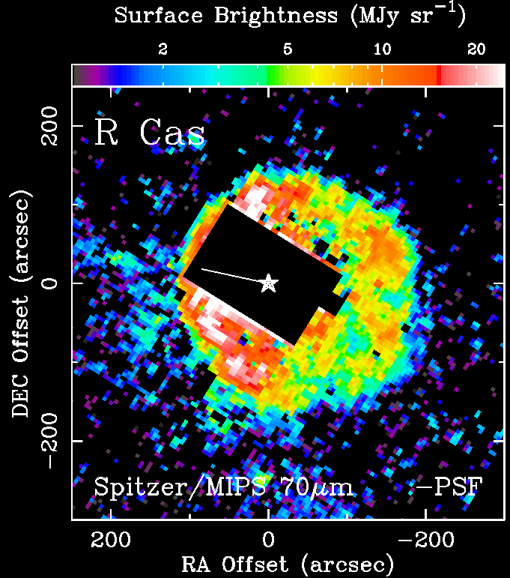
R Cas, 70 μm, MIPS*, Spitzer
(Thanks to Toshiya Ueto, DU)
*Multiband
Imaging
Photometer
for Spitzer

Slide 8
The Problem with R Cas
Source | Parallax (mas) | RMS Parallactic error (mas) | μ_{α} μ_{δ} | Type
HIPPARCOS (1997) | 9.37 | 1.10 | 84.39 ± 0.95 18.07±0.88 | Astrometric Satellite
Vlemmings, et al. | 5.67 | 1.95 | 80.52 ± 2.35 17.10 ± 1.75 | Phase Referencing VLBI

Slide 9
Paper 1:
“VLBI astrometry of circumstellar OH masers; proper motions and parallaxes of four AGB stars”
W.H.T. Vlemmings, H.J. van Langevelde, P.J. Diamond, H.J. Habing, and R.T. Schilizzi
Astron.Astrophys. 407 (2003) 213-224

Slide 10
The VLBA Observations
Vlemmings, et al. give a detailed description of the VLBA observations, but the astrometric reduction description leaves something to be desired.
Vlemmings, et al.: “The data was [sic!] then processed in AIPS without any special astrometric software. We rely on the VLBA correlator model and work with the residual phases directly. To be able to apply the phase, delay and phase rate solutions obtained on the continuum reference sources, a special task was written to connect the calibration of the wide band data to the spectral line data.”

Slide 11
VLBI Data Points
(from Paper 1)

Slide 12
Paul’s data read from the plot from Paper 1
Δα (mas)
-106.9000
-85.5000
-30.1000
-12.1000
9.3000
34.9000
83.4000
101.4000
Δδ (mas)
-16.2000
-23.0000
-4.8000
-0.5000
-5.2000
1.6000
12.2000
34.7000

Slide 13
Dates of VLBI Observation
(from Paper 1)
JD years from 2000.0
2451461 … -0.229979
2451564 ... 0.052019
2451703 ... 0.432580
2451789 ... 0.668036
2451894 ... 0.955510
2452057 ... 1.401780
2452329 ... 2.146475
2452407 ... 2.360027

Slide 14
Paul’s Simple model
Parallax Factors:
F_{α} = (1/15)*sec(δ)*( X_{earth}*sin(α) - Y_{earth}*cos(α) ) ,{timesec}
F_{α} = ( X_{earth}*sin(α) - Y_{earth}*cos(α) ) , {arcsec or mas}
F_{δ} = X_{earth}*cos(a)*sin(δ) - Y_{earth}* sin(a)*sin(δ) - Z_{earth}* cos(δ)
Then the coordinates are:
Δα = Δα₀ + μ_{α}*t + π*F_{α} {arcsec/milliarcsec}
Δδ = Δδ₀ + μ_{δ}*t + π*F_{δ}
(I got the (X,Y,Z)_{earth} from the USNO Multiyear Interactive Computer Almanac)

Slide 15
The Parallax Factors
RA parallax Factors (time units):
-0.2535
-0.7776
0.9127
0.3241
-0.8939
0.8588
-0.3770
0.7354
Dec parallax Factors:
0.6797
-0.5941
0.0587
0.8210
-0.1579
-0.0947
-0.8013
-0.2973

Slide 16
The conditions
A_arc =
1 t₁ F_{α1} 0 0
1 t₂ F_{α2} 0 0
1 t₃ F_{α3} 0 0
1 t₄ F_{α4} 0 0
1 t₅ F_{α5} 0 0
t₆ F_{α6} 0 0
0 0 F_{δ1} 1 t₁
0 0 F_{δ2} 1 t₂
0 0 F_{δ3} 1 t₃
0 0 F_{δ4} 1 t₄
0 0 F_{δ5} 1 t₅
0 0 F_{δ6} 1 t₆
A_arc =
1.0000 -0.2300 -0.2535 0 0
1.0000 0.0520 -0.7776 0 0
1.0000 0.4326 0.9127 0 0
1.0000 0.6680 0.3241 0 0
1.0000 0.9555 -0.8939 0 0
1.0000 1.4018 0.8588 0 0
1.0000 2.1465 -0.3770 0 0
1.0000 2.3600 0.7354 0 0
0 0 0.6797 1.0000 -0.2300
0 0 -0.5941 1.0000 0.0520
0 0 0.0587 1.0000 0.4326
0 0 0.8210 1.0000 0.6680
0 0 -0.1579 1.0000 0.9555
0 0 -0.0947 1.0000 1.4018
0 0 -0.8013 1.0000 2.1465
0 0 -0.2973 1.0000 2.3600
X ^{T} = (Δα₀ μ_{α} π Δδ₀ μ_{δ})

Slide 17
Paul’s simple (linear) solution
The equations of condition:
Y = A*X
The Simple solution
X = (A^{T}A)⁻¹A^{T}*Y

Slide 18
Paul’s simple (linear) solution
X ^{T} = (Δα₀ μ_{α} π Δδ₀ μ_{δ})
X ^{T} = (-75.52 76.40 6.87 -18.76 19.46)
σ_{x} = ( ±5.01 ±3.91 ±4.17 ±5.09 ±4.01)

Slide 19
SIMBAD Data
Basic data :
V* R Cas -- Variable Star of Mira Cet type
with radius arcmin
Other object types:
Mi* () , * (AG,BD,CSI,GC,GCRV,HD,HIC,HIP,HR,PPM,SAO,SKY#,UBV,YZ,[LFO93]) , IR (DIRBE,IRAS,IRC,2MASS,RAFGL) , ** (ADS,CCDM,IDS) , V* (V*,AAVSO) , Mas ([PCC93],[WCP90])
ICRS coord. (ep=2000 eq=2000) :
23 58 24.8725 +51 23 19.703 ( ~Unknown ) [ 8.27 7.39 89 ] A 1997A&A...323L..49P
FK5 coord. (ep=2000 eq=2000) :
23 58 24.873 +51 23 19.70 ( ~Unknown ) [ 8.27 7.39 89 ] A 1997A&A...323L..49P
FK4 coord. (ep=1950 eq=1950) :
23 55 51.69 +51 06 36.9 ( ~Unknown ) [ 48.21 44.62 86 ] A 1997A&A...323L..49P
Gal coord. (ep=2000 eq=2000) :
114.5608 -10.6191 ( ~Unknown ) [ 8.27 7.39 89 ] A 1997A&A...323L..49P
Proper motions mas/yr [error ellipse]:
84.39 18.07 A [0.95 0.88 86] 1997A&A...323L..49P
Radial velocity / Redshift / cz :
km/s 21.4 [0.9] / z 0.000071 [0.000003] / cz 21.40 [0.90] A 1953GCRV..C......0W
Parallaxes mas:
9.37 [1.10] A 1997A&A...323L..49P
Spectral type:
M7IIIe (D) ~
Fluxes (4) :
V 4.8 [~] C ~
J 0.163 [0.220] C 2003yCat.2246....0C
H -0.849 [0.170] C 2003yCat.2246....0C
K -1.404 [9.996] C 2003yCat.2246....0C

Slide 20
More SIMBAD Data
Identifiers (27) :
V* R Cas GC 33244 IRAS 23558+5106 UBV 21530
ADS 17135 A GCRV 14998 IRC +50484 YZ 51 8551
AG+51 1856 HD 224490 2MASS J23582487+5123190 [LFO93] 2355+51
BD+50 4202 HIC 118188 PPM 42410 [PCC93] 505
CCDM J23584+5123A HIP 118188 RAFGL 3188 [WCP90] 235552.000+510637.76
CSI+50 4202 1 HR 9066 SAO 35938 AAVSO 2353+50
DIRBE D23582487P5123190 IDS 23533+5050 A SKY# 45221

Slide 21
Revised HIPPARCOS Data
(from Imants’ copy of the
Revised HIPPARCOS Catalog
118188 9 5 1 6.2762616847 0.8969031141 5.50 86.40 18.60 0.62 0.77 1.13 0.89 0.84 174 1.31 0 0.0 102 8.6759 0.1229 1.415 1 1.500 0.510 5.340 2.21 0.28 1.95 0.05 -0.50 1.24 -1.01 -0.35 0.51 1.61 -0.44 -0.67 -0.09 -0.12 1.67

Slide 22
R Cas Parallaxes
Source | Parallax (mas) | RMS Parallactic error (mas) | μ_{α} μ_{δ} | Type
HIPPARCOS (1997) | 9.37 | ±1.10 | 84.39 ± 0.95 18.07±0.88 | Astrometric Satellite
Vlemmings, et al. | 5.67 | ±1.95 | 80.52 ± 2.35 17.10 ± 1.75 | (VLBI)
Paul’s fit to Paper 1 | 6.69 | ±4.17 | 76.4 ±3.91 19.5 ±4.01
HIPPARCOS (revised) | 5.50 | ±0.62 | 86.40 ± 0.77 18.60 ± 1.13 | Astrometric Satellite

Slide 23
BUT WAIT:
THERE’s MORE!!!!
From Floor van Leeuwen, 11 September 2008 (Private Communication)
“Forgot to reply on R Cas. I clearly have to close and replace the Vizier
version of the catalogue as something has gone wrong there. The value I
have here and which should instead be on Vizier is 7.95+-1.02”
(emphasis – PDH). (Floor did replace the Vizier HIPPARCOS entries
within the day, according to a different e-mail to Michael Ratner at
CfA about IM Peg…but that’s ANOTHER story!)

Slide 24
R Cas Parallaxes
Source | Parallax (mas) | RMS Parallactic error (mas) | μ_{α} μ_{δ} | Type
HIPPARCOS (1997) | 9.37 | ±1.10 | 84.39 ± 0.95 18.07±0.88 | Astrometric Satellite
Vlemmings, et al. | 5.67 | ±1.95 | 80.52 ± 2.35 17.10 ± 1.75 | (VLBI)
Paul’s fit to Paper 1 | 6.69 | ±4.17 | 76.4 ±3.91 19.5 ±4.01
HIPPARCOS (revised) | 5.50 | ±0.62 | 86.40 ± 0.77 18.60 ± 1.13 | Astrometric Satellite
HIPPARCOS (re-revised Yet again) | 7.95 | ±1.02 | From Visier last night, (no σ’s) 85.52 17.49 | Astrometric Satellite

Slide 25
Sooooooo:
Welllll, we don’t have the answer
yet

Slide 26
Bill van Altena’s Conclusions:
Everybody thinks Astrometry is simple
but hardly anybody gets it right.
2. Nobody is being trained to do Astrometry anymore.

Slide 27
Acknowledgements
Toshiya Ueto and Bob Stencil
(for pointing out the astrometric-astrophysical
discrepancy)
Imants Platais
(for pointing me to the new HIPPARCOS
reduction)
Floor van Leeuwen for a last minute e-mail
AND OF COURSE:
Bill, for encouraging me in astrometry in the first
place, and for being the subject of this symposium.

